Slide 1
Propose Ethernet Wiring (Decada Robotics@TRL)

Slide 2

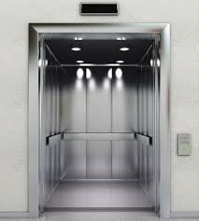
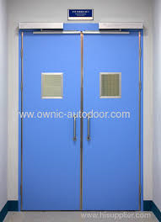
BMS Network Switch
PLC
Spare Network Switch
Decada Edge
Computer
Lvl6 PoE Point
Level 6
Lvl6 Door
Lift
Xnergy W.C
Decada
Internet Network Switch
Lvl4 PoE Point
Level 5
Lvl5 Door
TRL Server Room
Lvl4 PoE Point
Xnergy W.C
Level 4
Lvl4 Door
Lvl3 PoE Point
Level 3
Lvl3 Door
Lvl2 PoE Point
Level 2
Lvl2 Door
LvlB1 PoE Point
Level B1

Slide 3
Wiring requirements
Lvl B1 – x1 Eth Port (no auto doors, 1 for spare)
Lvl 2-5 – x2 Eth Port each (1 for door, 1 for spare)
Lvl 6 – x4 Eth Port (1 for door, 1 for spare)
(Lift PLC to have x2 lan cables for redundancy)
Wireless charger to deploy at level 4 and 6

Slide 4
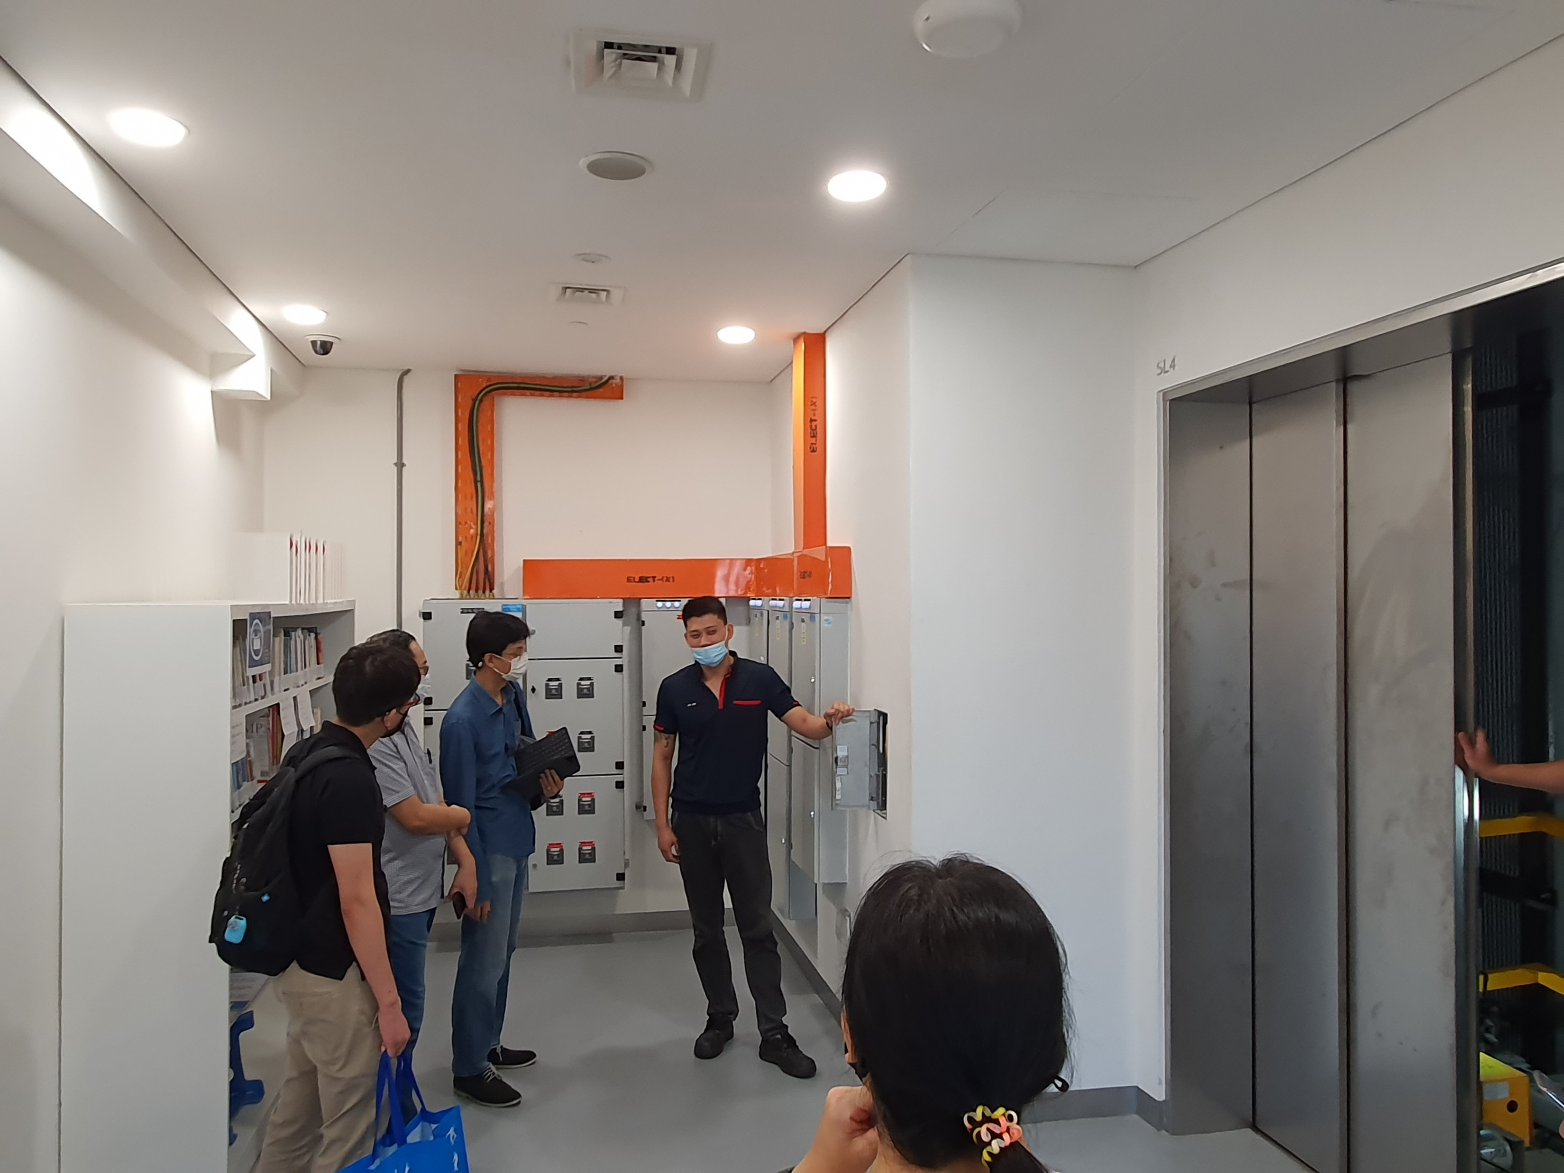
Level 6
Proposed Switch Mounting Box

Slide 5
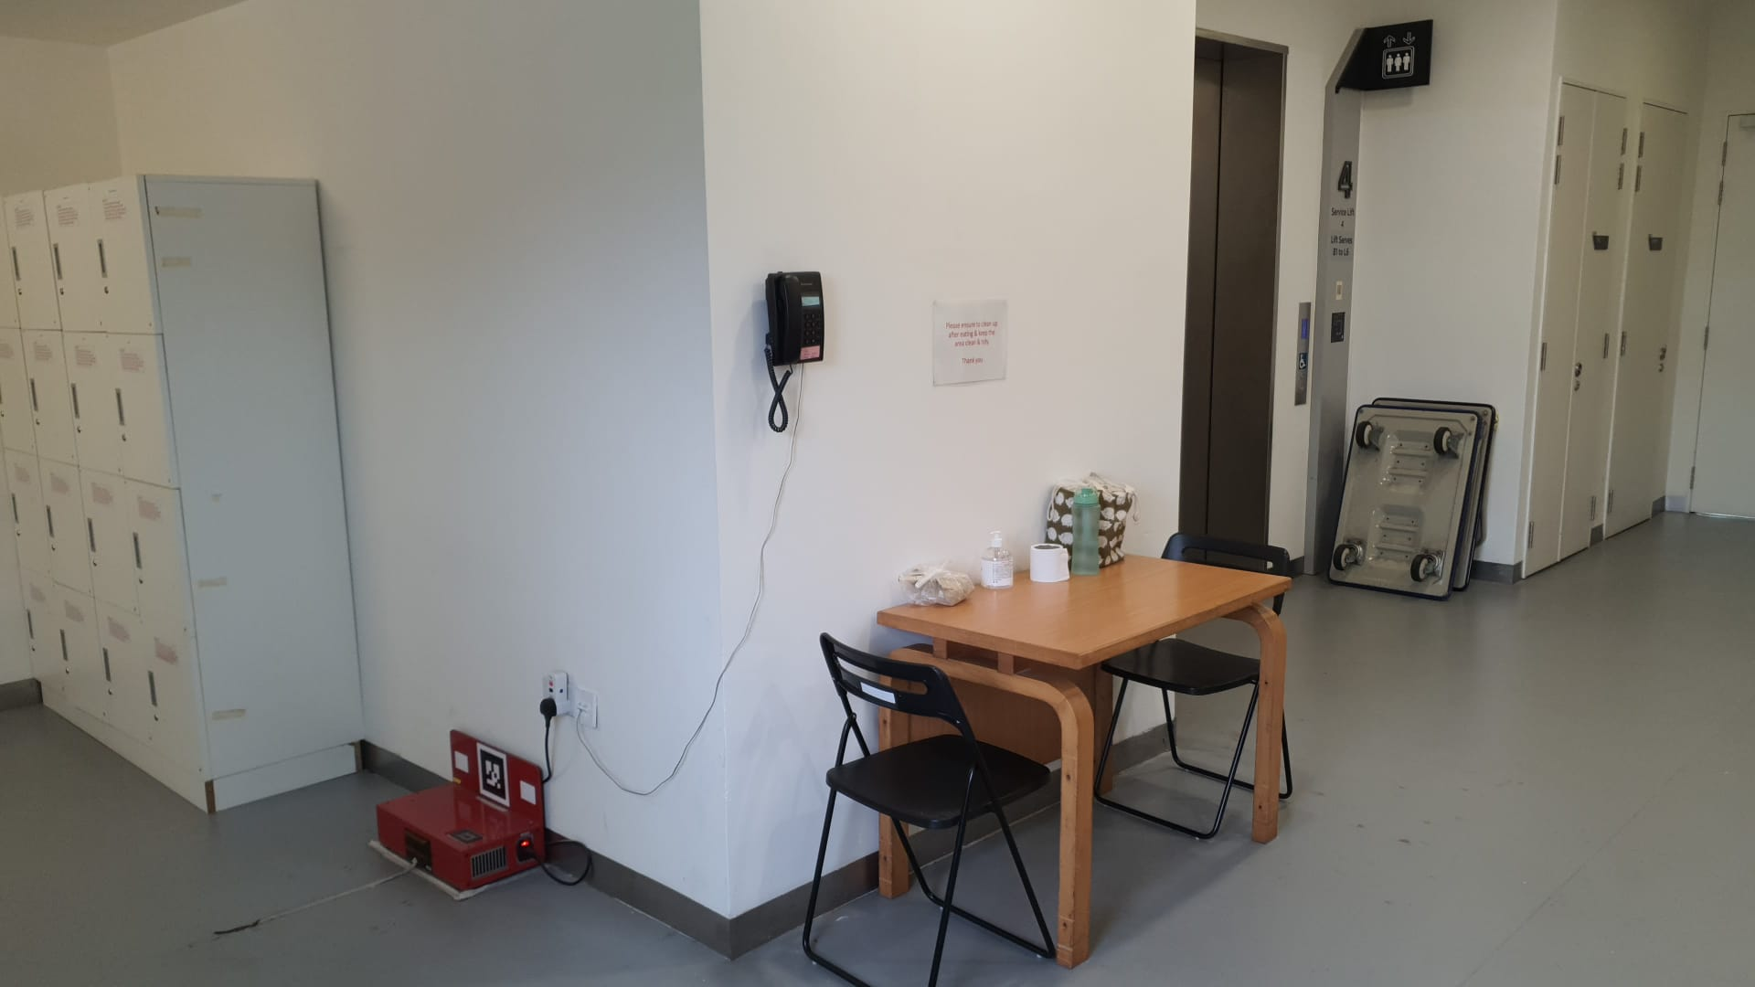
Level 4
Proposed Switch Mounting Box

Slide 6
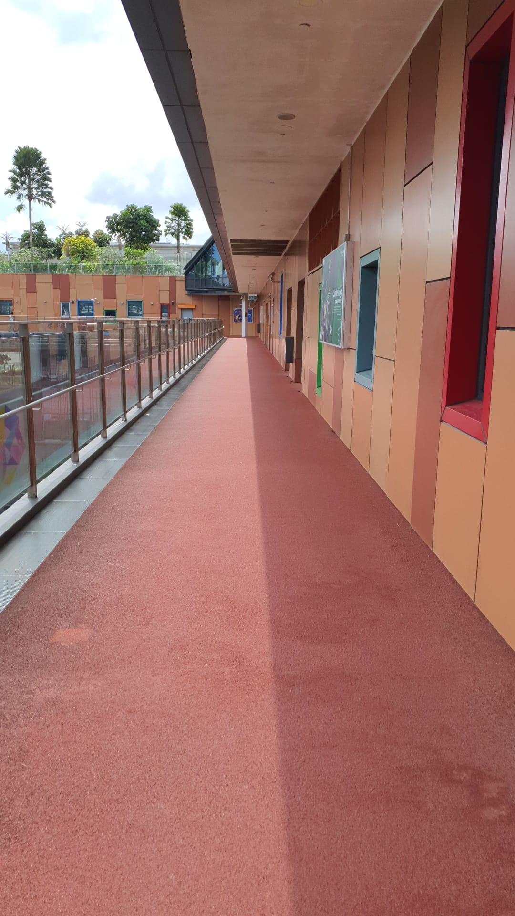
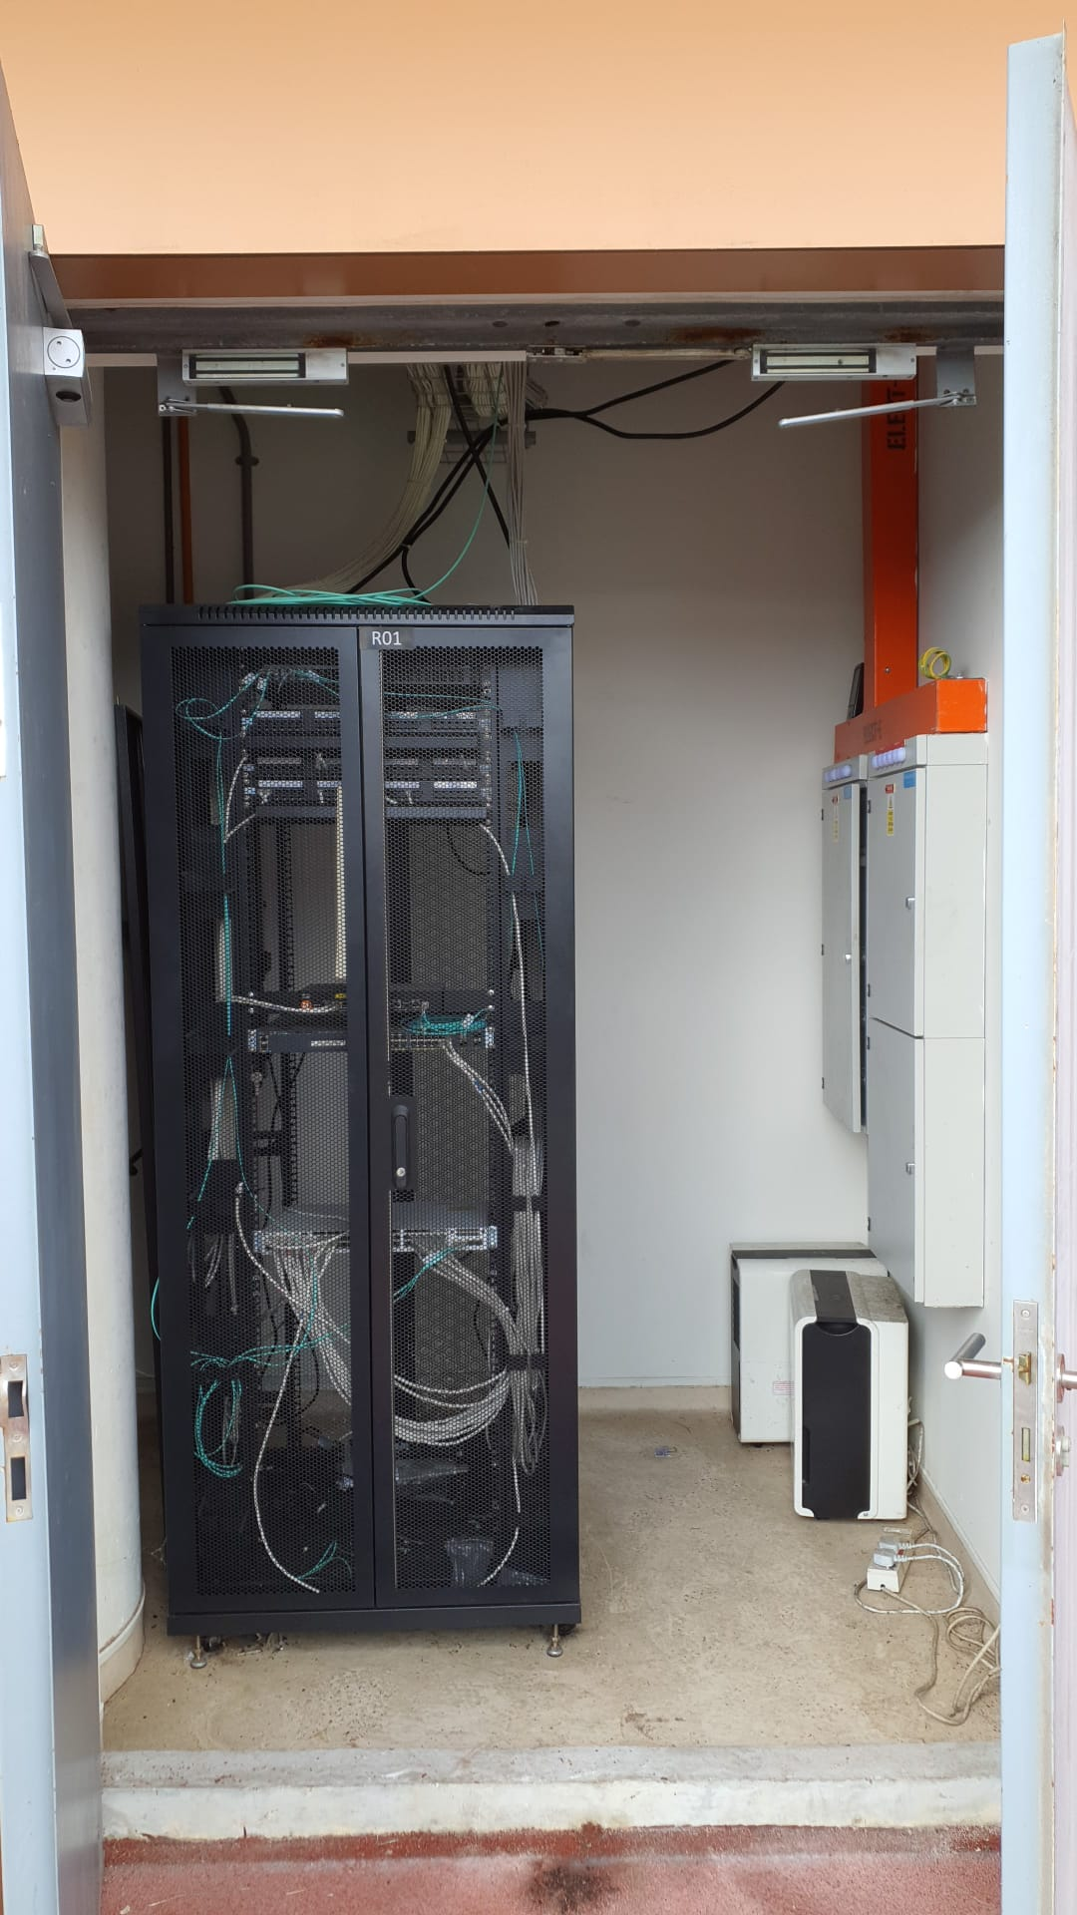
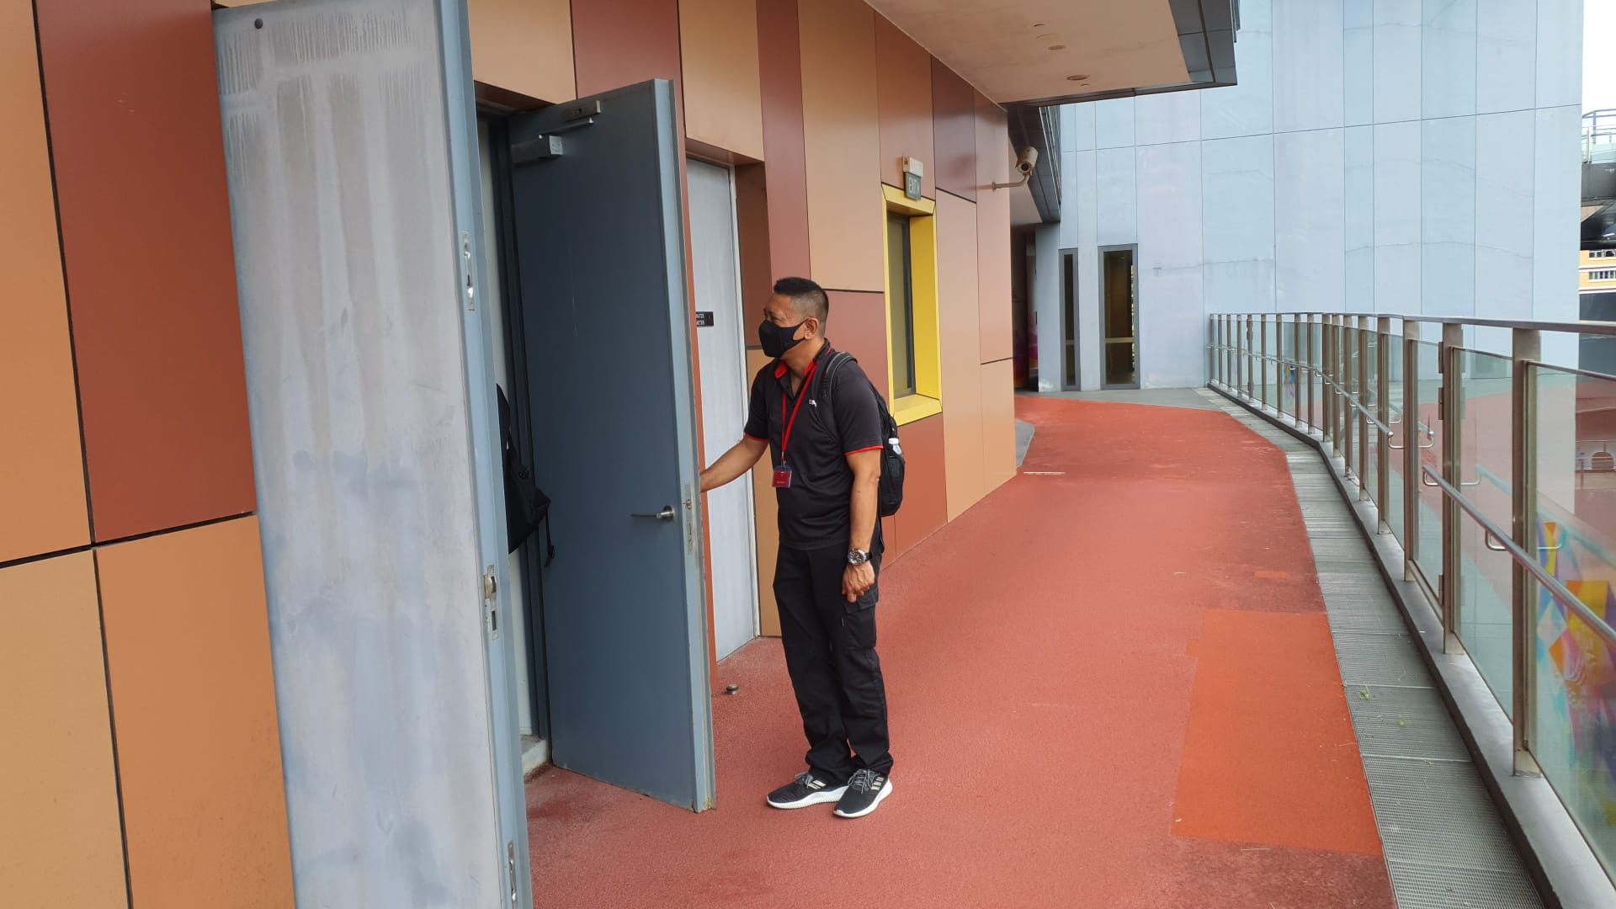
Trunking switch to Server room

Slide 7
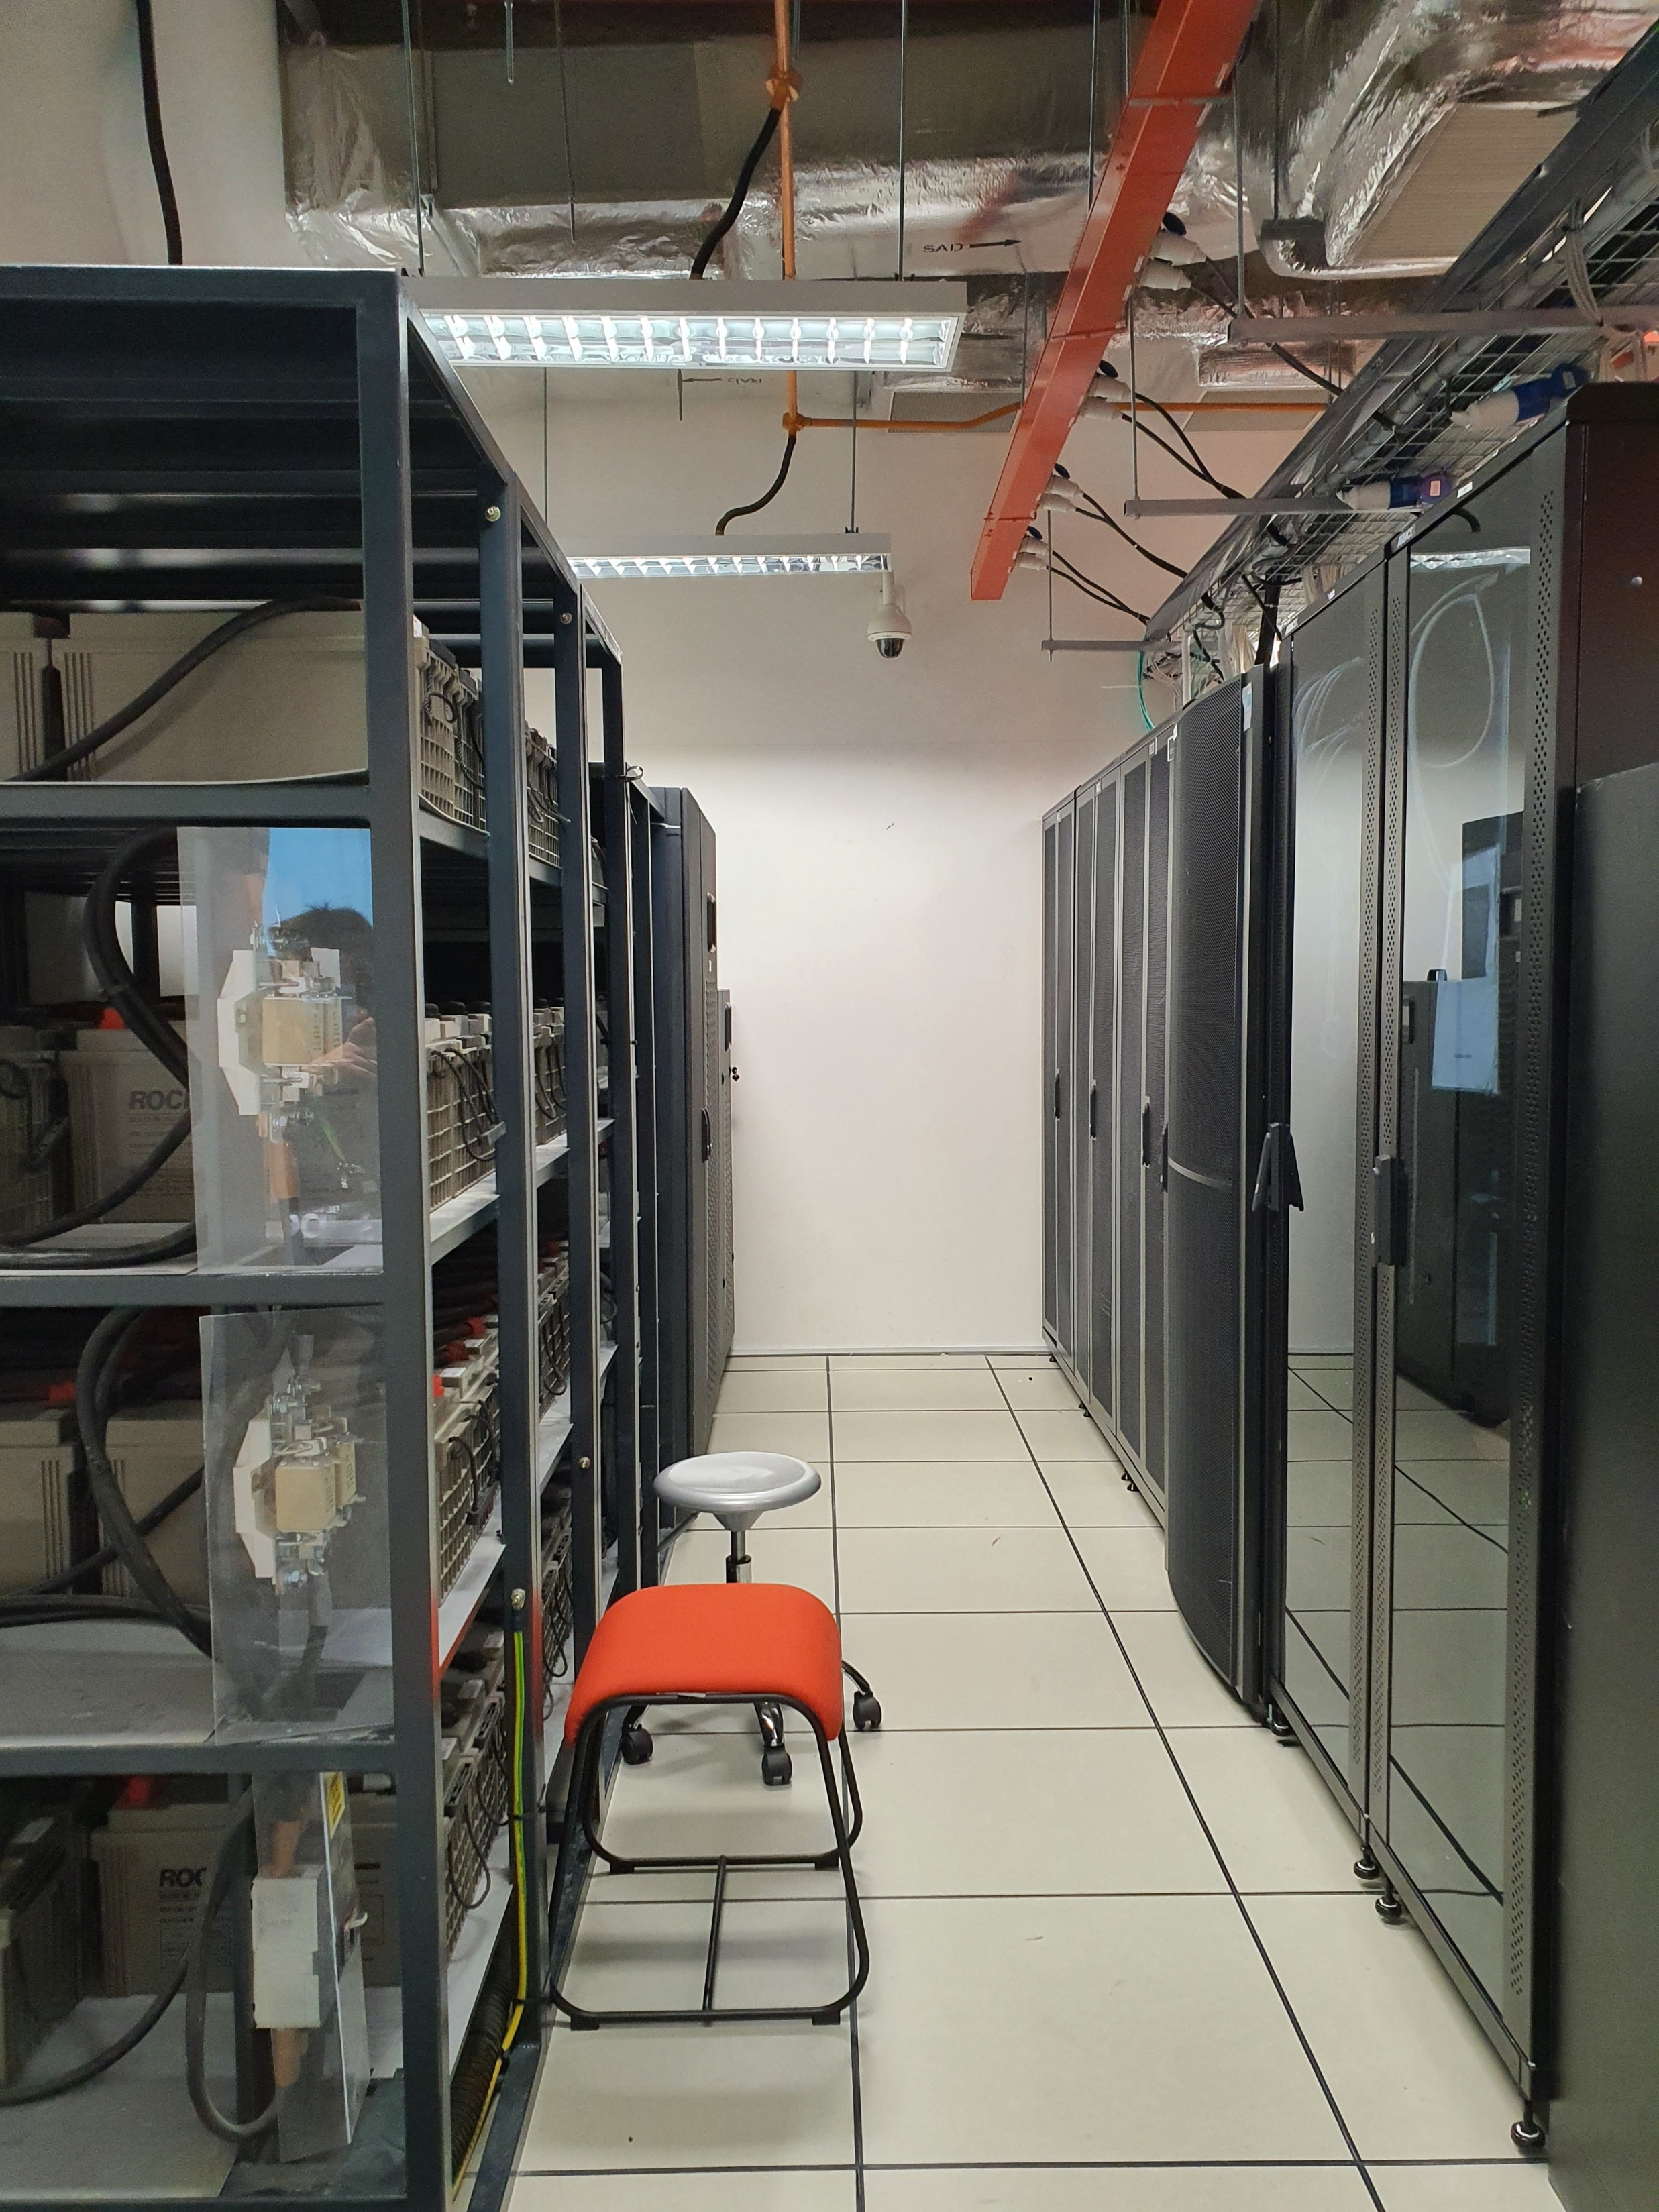
Server room

